Slide 1



CLOUDBOOSTA ACADEMY
PROJECT PRESENTATION
AWS CloudTrail Log Monitoring: Integrating CloudTrail Logs Into CloudWatch

Slide 2
3
3
Introduction
5
AWS Services Used
TABLE
OF
CONTENT
7
System Architecture
10
Implementation
23
Security Considerations
26
Cost
28
Challenges
30
Future Enhancements and Recommendations

Slide 3
INTRODUCTION

Slide 4

By leveraging CloudTrail logs and CloudWatch Metrics, we created a seamless pipeline that monitors EC2 state changes. When an instance exceeds the threshold of stop events, an alarm is automatically triggered in CloudWatch.
This alarm then notifies stakeholders via Amazon SNS (Simple Notification Service), enabling timely intervention or investigation.
This approach ensures proactive monitoring, enabling better insight into instance usage patterns and potential operational issues.

Slide 5
AWS
SERVICES USED

Slide 6








Amazon Elastic Cloud Compute
Amazon Simple Storage Service
AWS CloudTrail
AWS Identity and Access Management
AWS CloudWatch
Amazon Simple Notification Service

Slide 7
SYSTEM
ARCHITECTURE

Slide 8
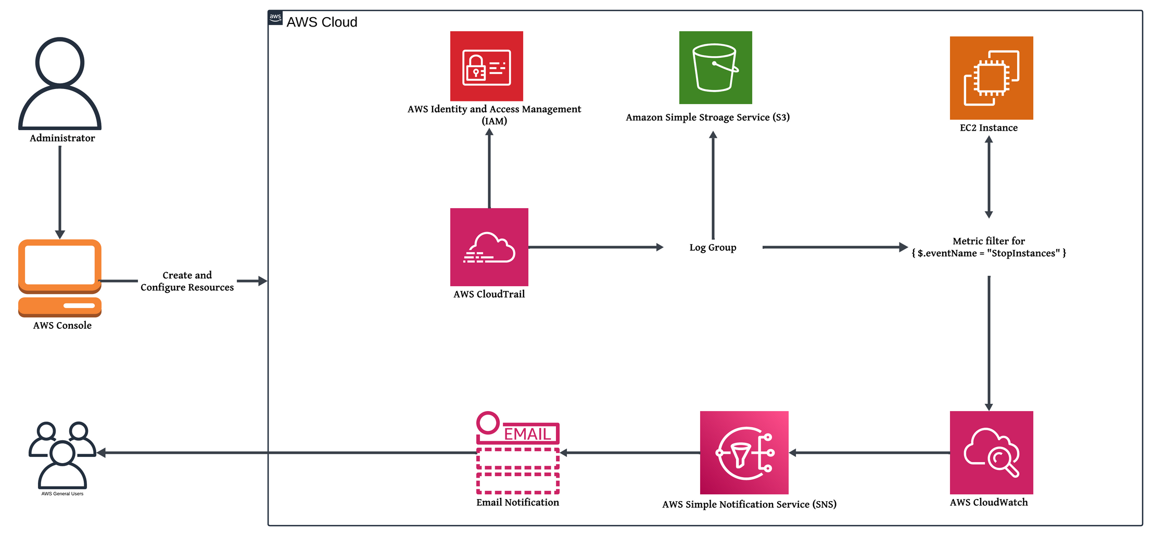
Stakeholders
(HODs, Cloud Engineers, etc)

Slide 9

DATA FLOW SEQUENCE
The CloudWatch Metric Filter scans the logs for occurrences of the StopInstances event using the filter expression $.eventName = "StopInstances"
The end-user receives an email notification informing them that the EC2 instance has been stopped multiple times
When the user stops an EC2 instance, an event is generated
When the count is more than once, a CloudWatch Alarm is triggered
1
2
3
4
5
6
7
8
The user initiates the process by configuring the resources through the AWS console
AWS CloudTrail captures the StopInstances event and stores the logs in an associated Log Group
When a stop event is detected, it updates a custom metric. The custom CloudWatch metric counts the number of stop events for the EC2 instance
Once the CloudWatch Alarm is triggered, it sends a notification to the SNS Topic

Slide 10
IMPLEMENTATION

Slide 11
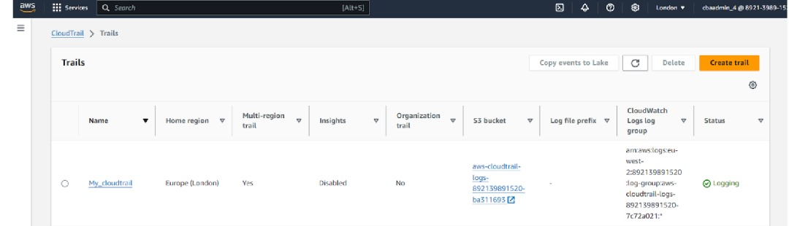
1.Creating a Trail
We enabled AWS CloudTrail to log all events (management events) related to the EC2 instance, particularly focusing on instance start and stop operations.
The logs were configured to be sent to a CloudWatch Log Group for further processing and monitoring.

Slide 12
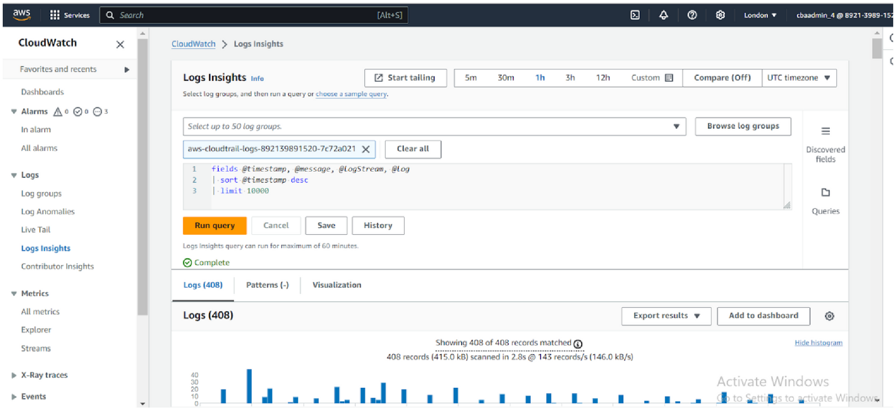
2.Using CloudWatch Log Insights
We selected the log group from the drop-down, and ran query.
The query results were used to monitor security incidents and operational issues.

Slide 13
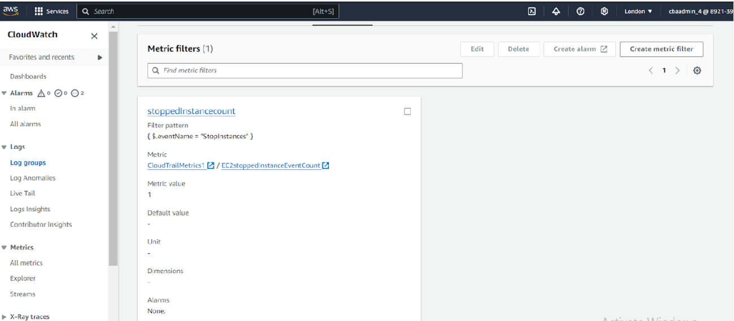
3.Creating Metric Filters for Log Groups in CloudWatch
We navigated to the Log Group where CloudTrail logs are stored.
A Metric Filter was created using the following pattern to detect EC2 stop events:{ $.eventName = "StopInstances" }
This Metric Filter converts each StopInstances event from the CloudTrail logs into a custom metric that can be tracked over time.

Slide 14
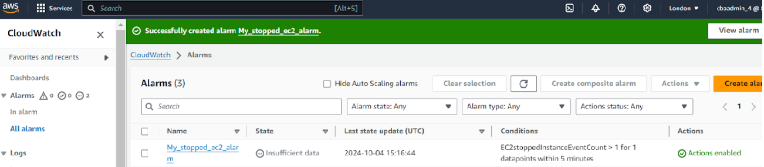
4.Creating an Alarm
The alarm was configured to trigger if the custom metric (tracking stop events) detected more than one stop in a specified period (5 minutes).
The alarm sent notifications via Amazon SNS to alert the team when the EC2 instance was stopped multiple times.

Slide 15
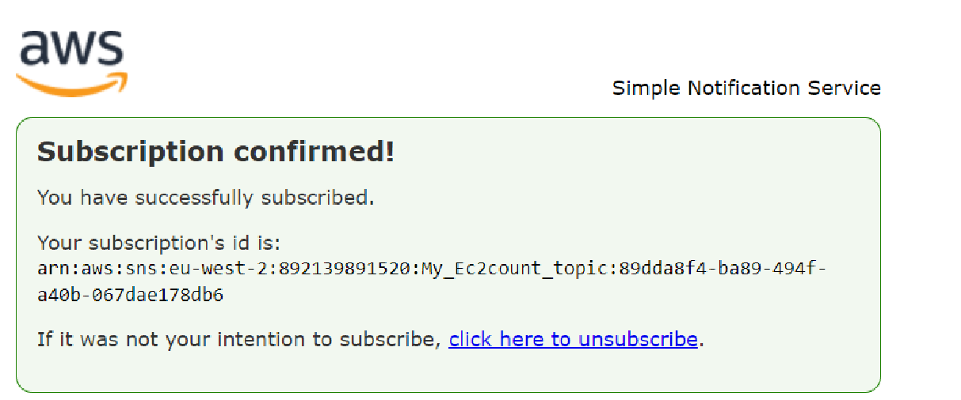
5.Amazon SNS for Notifications
An SNS topic was created, and email addresses of administrators were subscribed to this topic.
When the CloudWatch Alarm was triggered (due to repeated EC2 stop events), SNS sent an email notification to alert the team. This allowed immediate intervention.

Slide 16
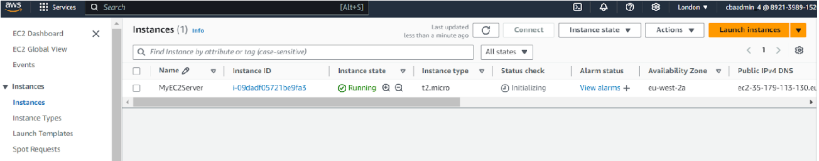
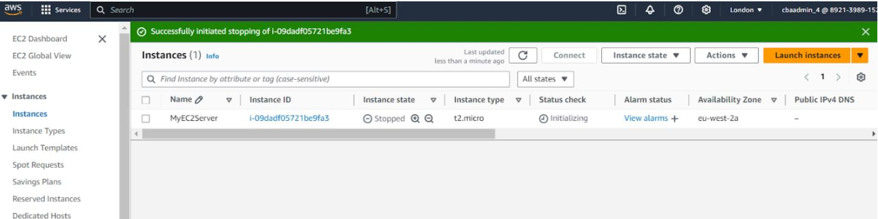
6.Creating an EC2 Instance to Trigger the Alarm
The EC2 instance was first started and allowed to run.
Then, we manually stopped and restarted the EC2 instance two times to trigger the CloudWatch Alarm.

Slide 17
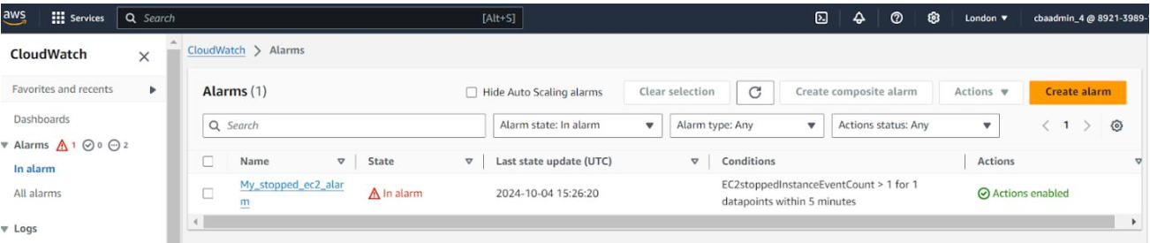
7.Alarm and Notifications (In Alarm)
The custom metric (tracking EC2 stops) exceeded the threshold (more than one stop), which activated the alarm.

Slide 18
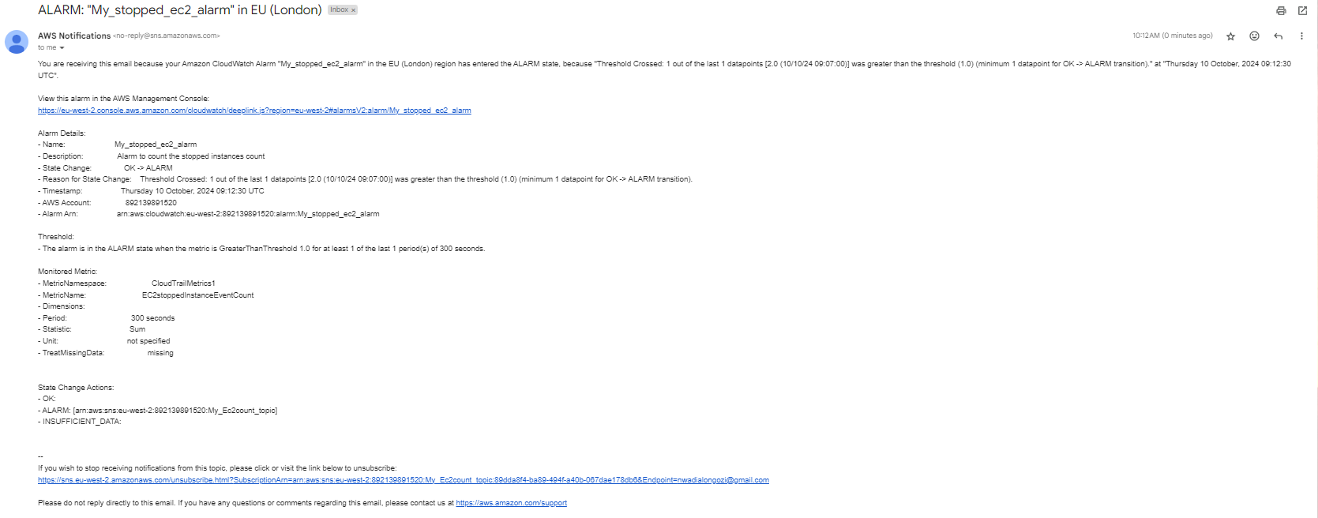
7.Alarm and Notifications (Email)
The alarm sent an email notification to administrators via SNS, informing them of the repeated EC2 stops.

Slide 19
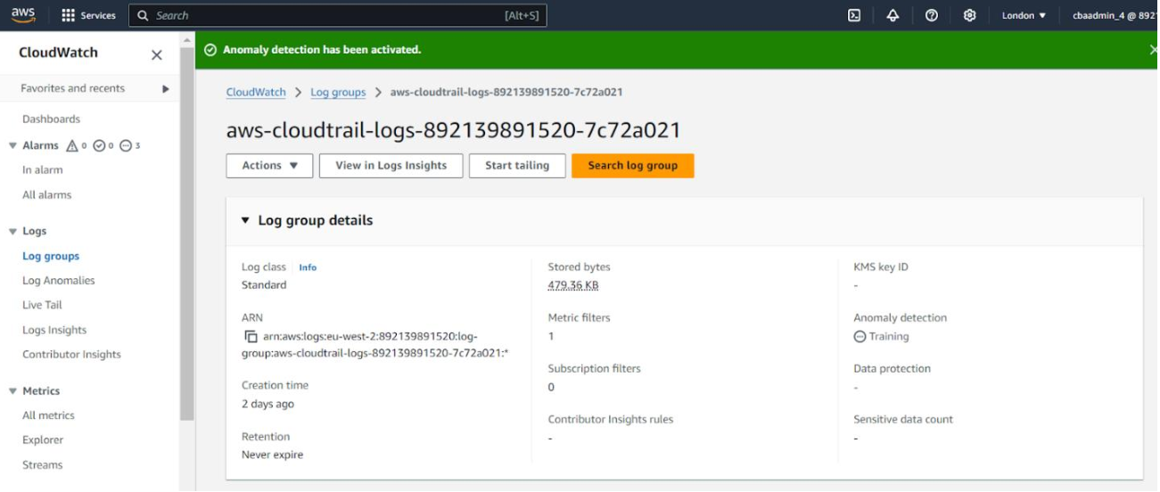
8.Setting Up CloudWatch Metric Anomaly Detection
We went to Log Groups and selected the concerned log group.
Under Actions, we selected Anomaly Detection and clicked on Configure.
Anomaly detection sensitivity can be adjusted based on historical data to ensure that unusual patterns in EC2 stops would be detected automatically.
This added another layer of monitoring, using machine learning to detect unexpected behavior in instance stops.

Slide 20
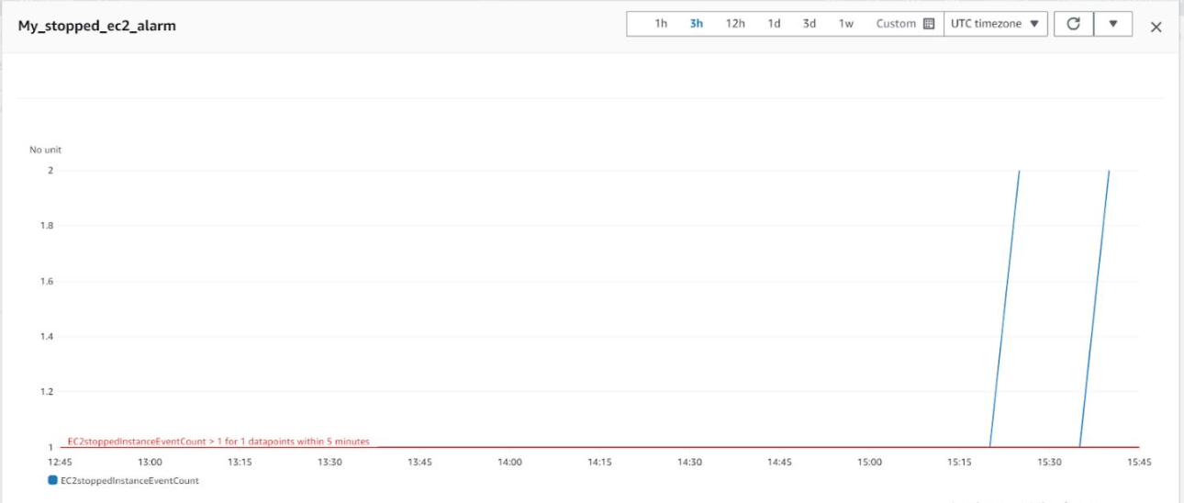
9.Creating a CloudWatch Dashboard
We selected the alarm and clicked on the dropdown arrow next to Action, then Add to Dashboard.
We selected line graph as the widget type to display the metric.
The EC2 stop events were then visualized in the dashboard, allowing the team to see how frequently the instance was stopped and track the alarm's status
Dashboard after two alarms

Slide 21
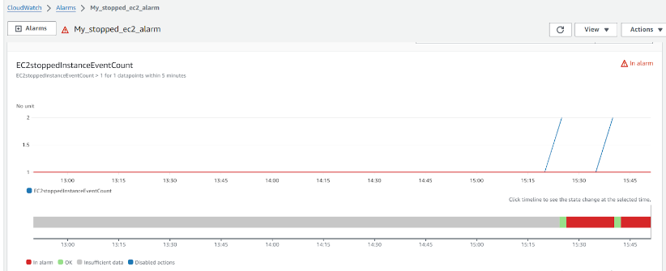
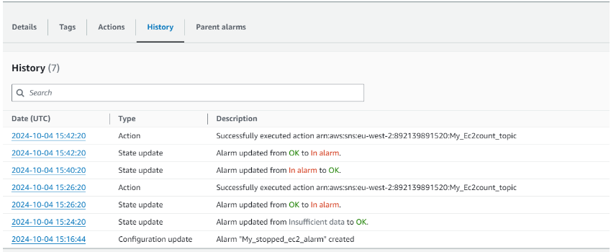
StopInstance Alarm in CloudWatch
Alarm History in CloudWatch

Slide 22
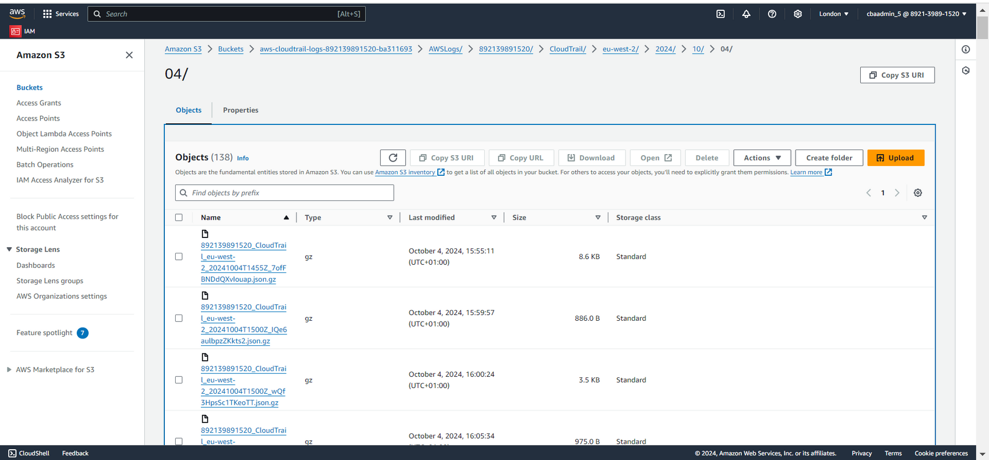
S3 Bucket for Storage of Logs
Event Logs generated are recorded and delivered to S3 bucket within the assigned threshold of 5 minutes.

Slide 23
SECURITY CONSIDERATIONS

Slide 24
1. IAM Permissions
2.Encryption
Enforce the principle of least privilege by ensuring that only authorized users have access to the CloudWatch Logs, CloudTrail, and SNS resources.
Limit permissions for starting, stopping, and terminating EC2 instances to trusted administrators only.
Enable encryption at rest for all CloudTrail logs using AWS KMS to protect sensitive data.
Ensure encryption in transit is enabled for communication between AWS services and for notifications sent via SNS.

Slide 25
3.Audit Logging
4.Log Retention and Rotation
CloudTrail’s detailed audit logs provide an invaluable resource for tracking changes and ensuring accountability.
Retain logs for a suitable period to meet compliance requirements and for security investigations.
Implement appropriate log retention policies to balance storage costs with the need for keeping historical data for auditing.

Slide 26
COST

Slide 27
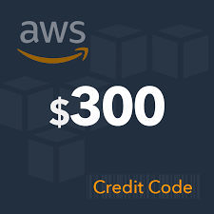
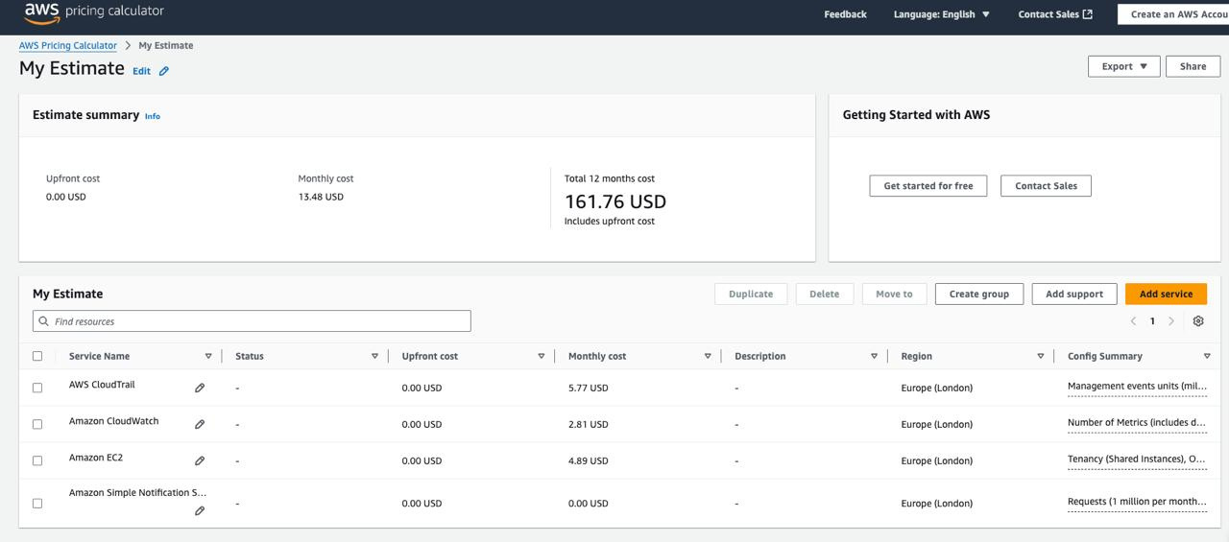
AWS Credit
We received the AWS $300 free credit which we utilized for the project.
Out of the credit, we used $13.48 which we estimated using the AWS Pricing Calculator.
Therefore, there was no need to spend outside of the credit.

Slide 28
CHALLENGES

Slide 29
1. Inaccessible AWS Service
2. Time Constraint
The first project topic we started working on needed an AWS service which is not accessible to new accounts in AWS.
Since we had 2 project options, we then decided to port to the other topic after over 2 weeks of trying.
As a result of the challenge faced in the first project (of which we had invested over 2 of 4 weeks into), time was against us in the implementation of this project.
We literarily rushed the implementation of this project, in order to meet up with the deadline.

Slide 30
FUTURE ENHANCEMENTS AND RECOMMENDATIONS

Slide 31
1. Enhanced Security Monitoring
2. Cost Optimization
Integrate AWS GuardDuty to extend security monitoring beyond instance stops. GuardDuty provides threat detection and continuous monitoring for malicious activity, such as unauthorized API calls or compromised EC2 instances.
Implement strategies to reduce operational costs, such as reviewing log retention policies, compressing logs, and filtering unnecessary events before they are sent to CloudWatch Logs. Customizing your metric collection and alerting for only critical events can reduce expenses while maintaining efficient monitoring.

Slide 32

Thank
You!

